Slide 1
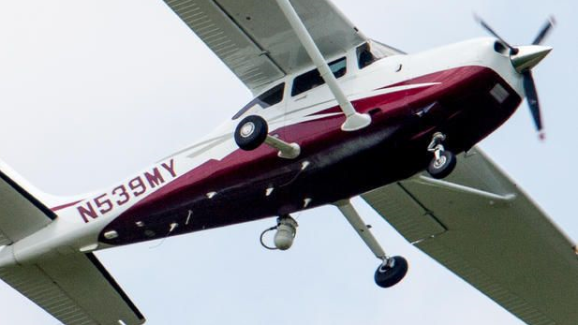

Slide 2
Capstone Project (DAEN 690 -Spring 2018) Spy Plane Finder

Slide 3



Team members
Meghna Kathuri
Shreyasi Thota
Shravan Chintha

Slide 4
Problem definition
Various aircrafts perform several surveillance operations over the united states which are operated by the FBI and the Department of Homeland Security whose identification is hidden and open in a few cases.
Why are these aircrafts registered under fictions companies and what is the pattern of their surveillance operations?

Slide 5
Goal
Our goal is to analyze and train a machine learning algorithm that will detect aircrafts that perform surveillance over US, based on their features

Slide 6
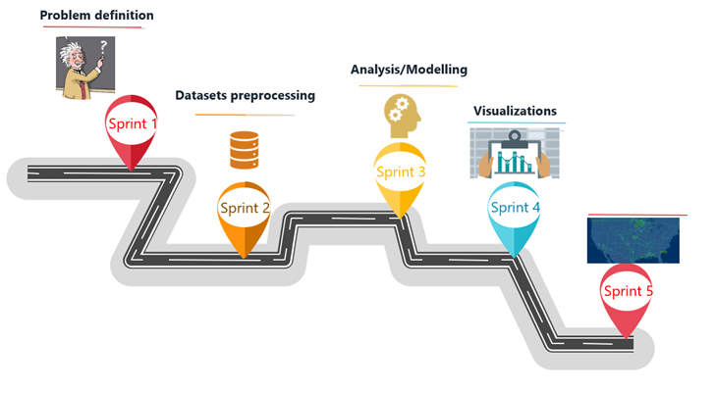
Project Roadmap
Validation

Slide 7
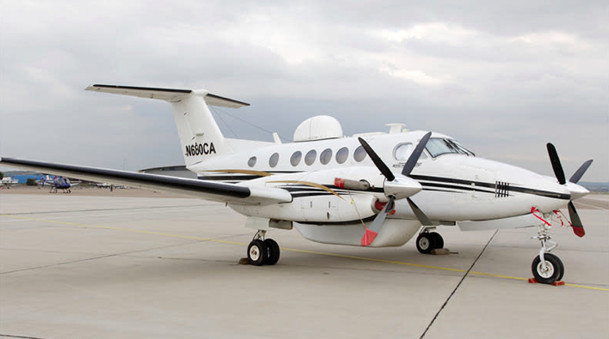
SURVEILLANCE AIRCRAFT
Features :
Higher speed
Augmented Technology
Video and audio taping
Low noise
Surveillance features

Slide 8
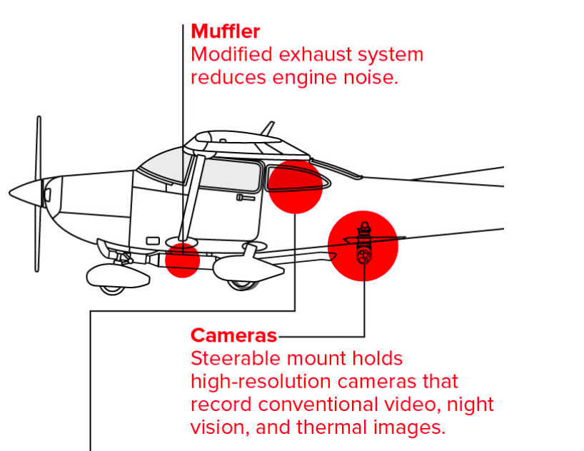
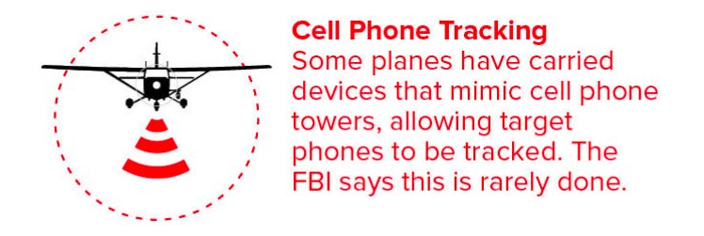
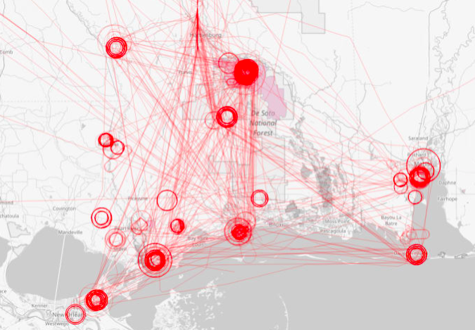

Flight path of Acorn plan from 2015 to 2017

Slide 9




Data pipeline
1. Data collection
3.Data pre-processing
2. Explore
5. Validation
4. Modelling
6).Insights

Slide 10
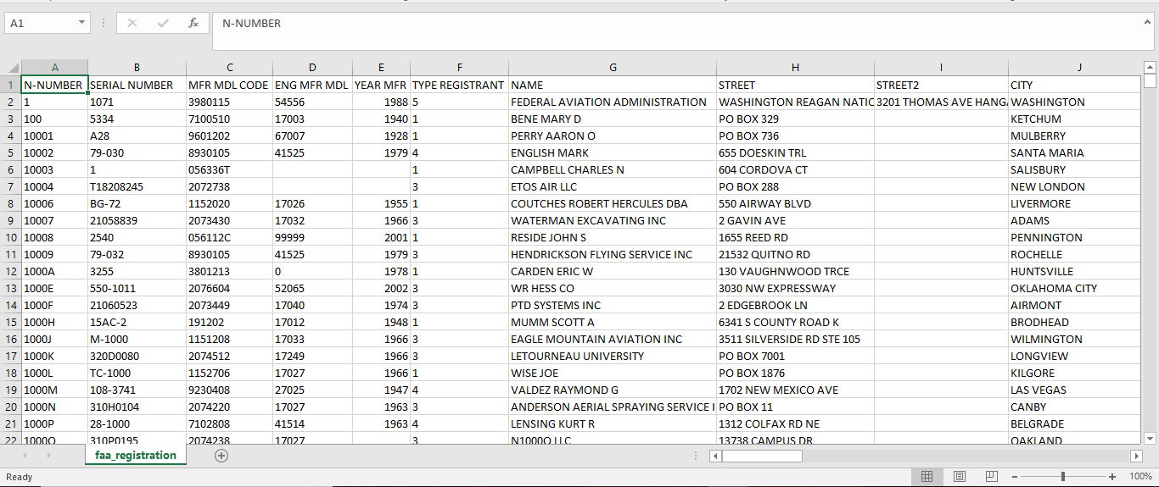
Dataset – Plane registration details

Slide 11
Feature engineering
Removed planes which are registered in countries other than the US
Planes with type commercial are also removed from the data
Duration of each flight recorded is divided into multiple segments to study the flight time
Boxes i.e., area bounding a flight segment in sq. kms, it is also divided and studied to get the area covered by the flight.

Slide 12
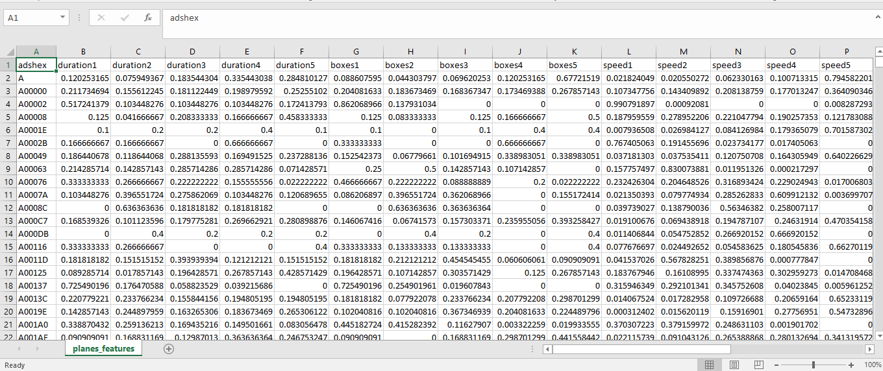
Dataset – Plane features

Slide 13
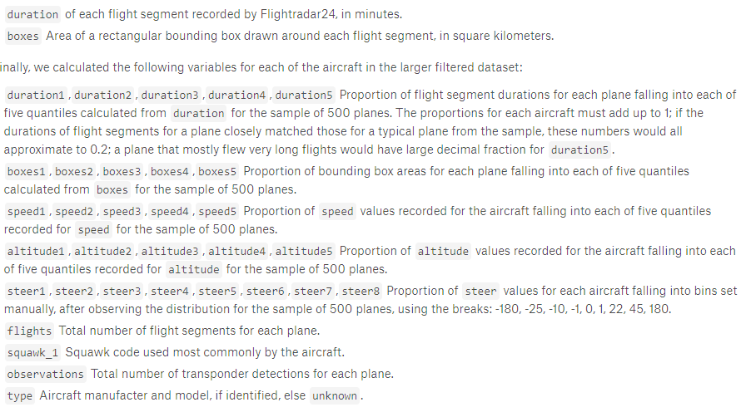
Data dictionary – Plane features

Slide 14
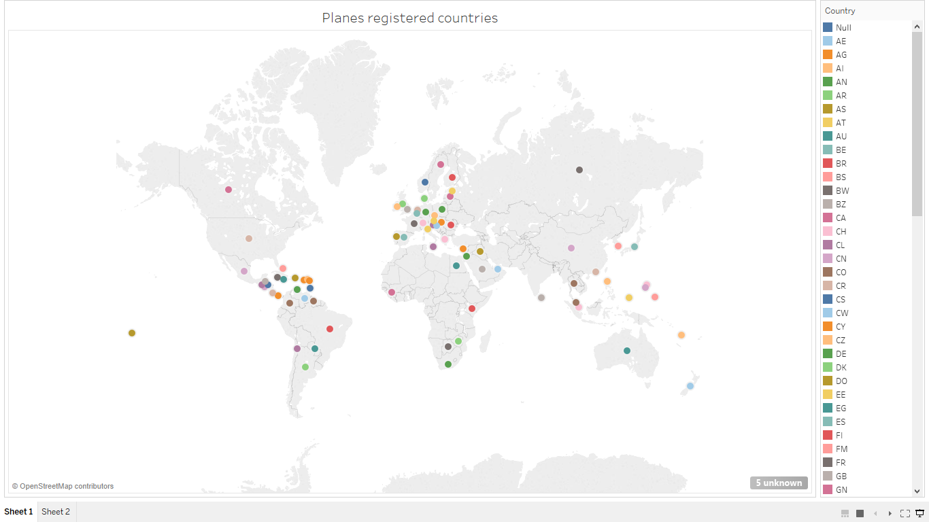
Exploratory data analysis

Slide 15
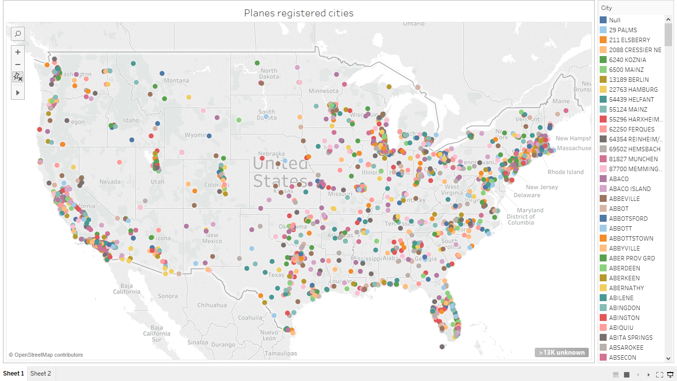

Slide 16
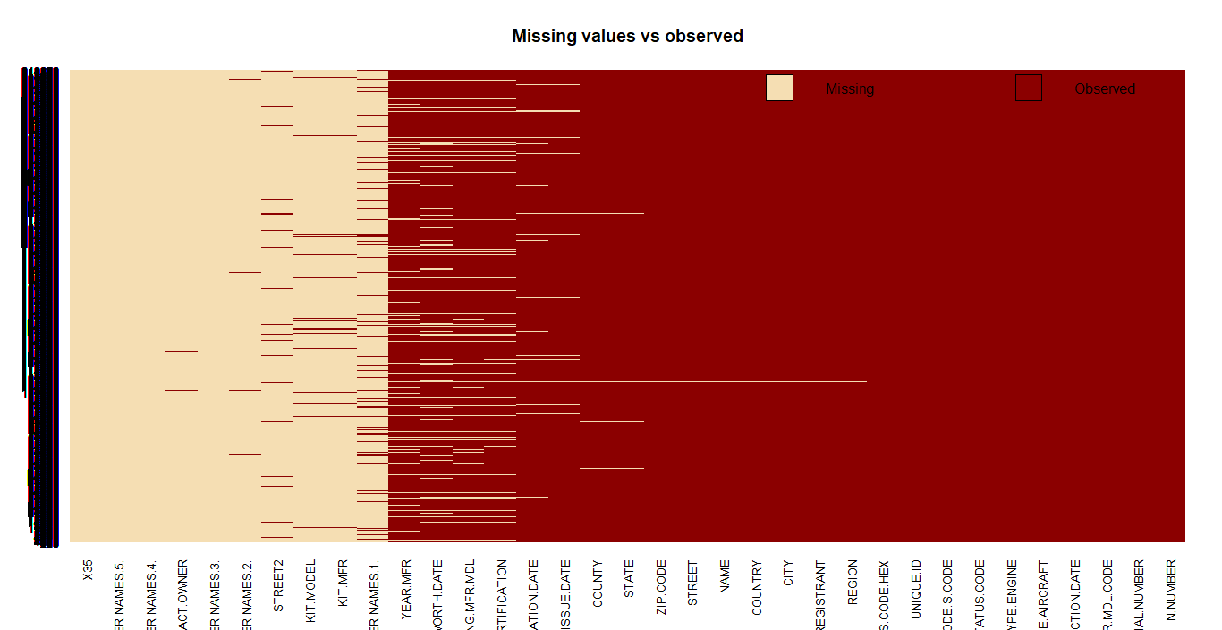
Missing values observed

Slide 17
Modeling

Slide 18
Training data
597 planes data, which are already classified as Surveillance or Others category

Slide 19
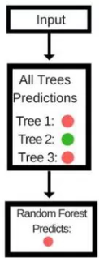
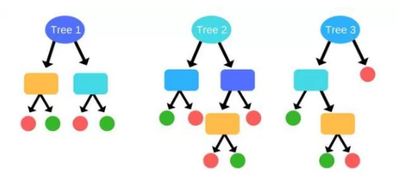
Random Forest
A Random Forest consists of an arbitrary number of simple trees, which are used to determine the final outcome. For classification problems, the ensemble of simple trees vote for the most popular class.

Slide 20
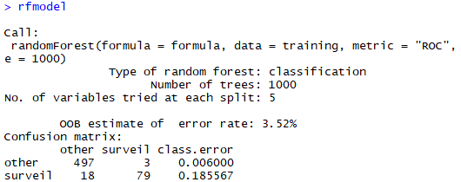
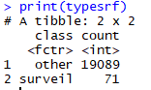
Random Forest

Slide 21
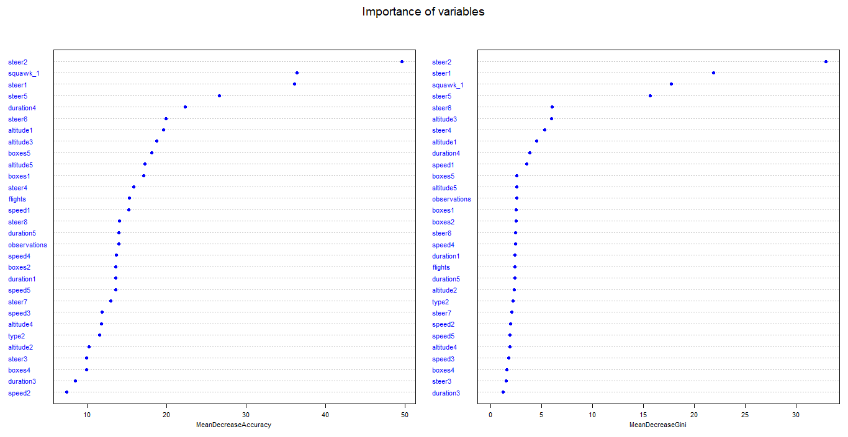
Importance of variables

Slide 22
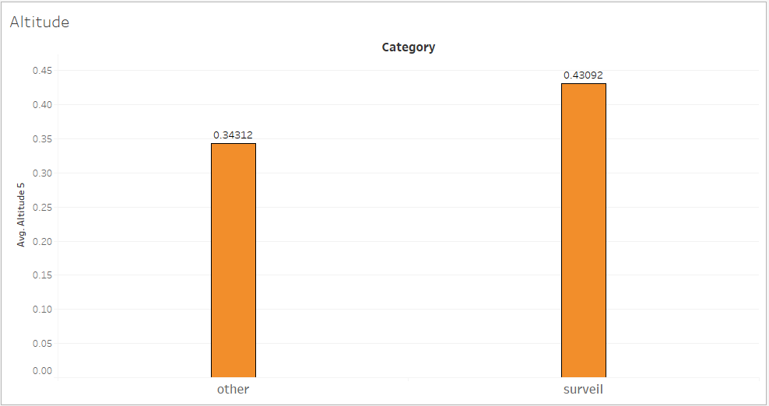
Data insights - Altitude

Slide 23
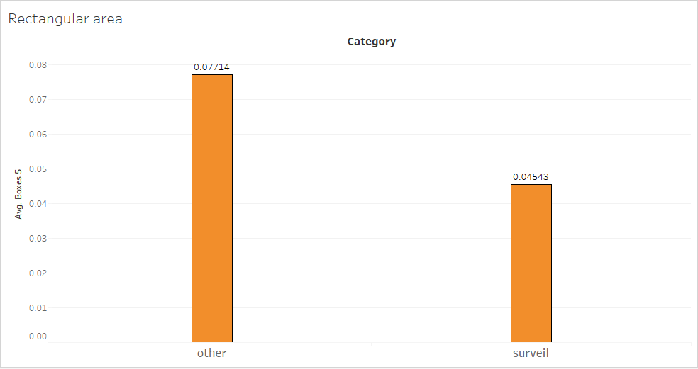
Data insights – Rectangular Area

Slide 24
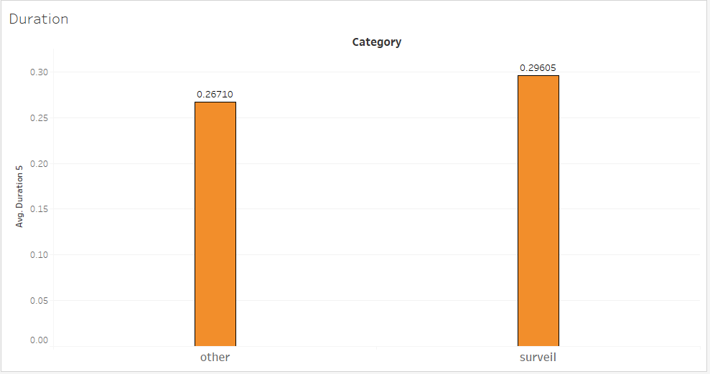
Data insights - Duration

Slide 25
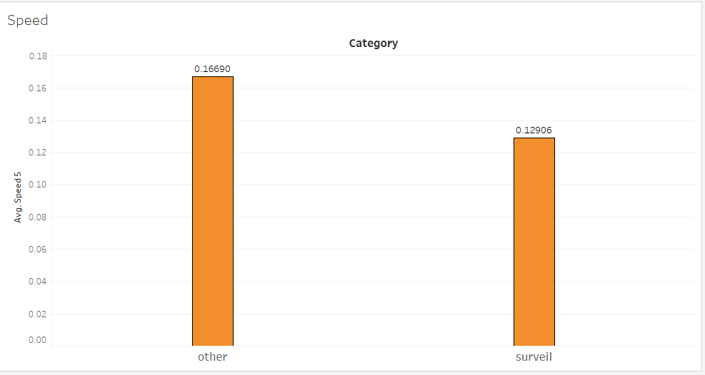
Data insights - Speed

Slide 26
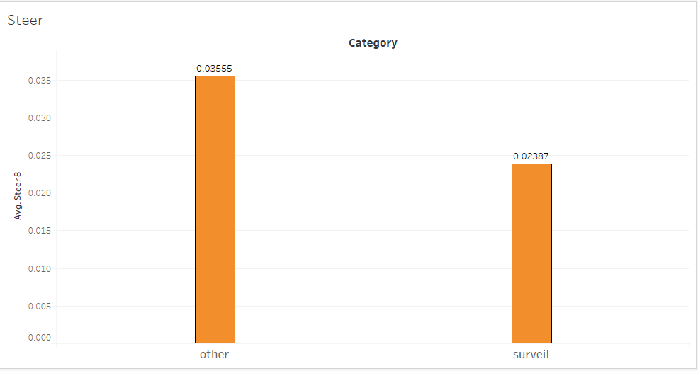
Data insights - Steer

Slide 27
Why tree models?
Decision trees are simple but intuitive models
Utilize a top-down approach in which the root node creates binary splits until a certain criteria is met
Decision trees implicitly perform variable screening or feature selection
Decision trees require relatively little effort from users for data preparation
Nonlinear relationships between parameters do not affect tree performance

Slide 28
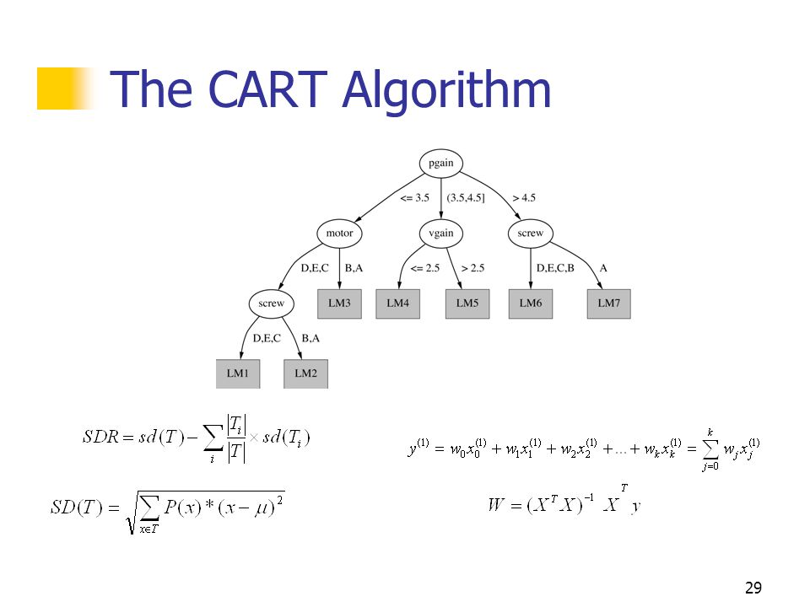
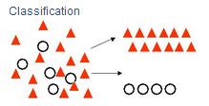
CART
Classification and Regression Trees
Classification and Regression Trees (CART) split attributes based on values that minimize a loss function, such as sum of squared errors.

Slide 29
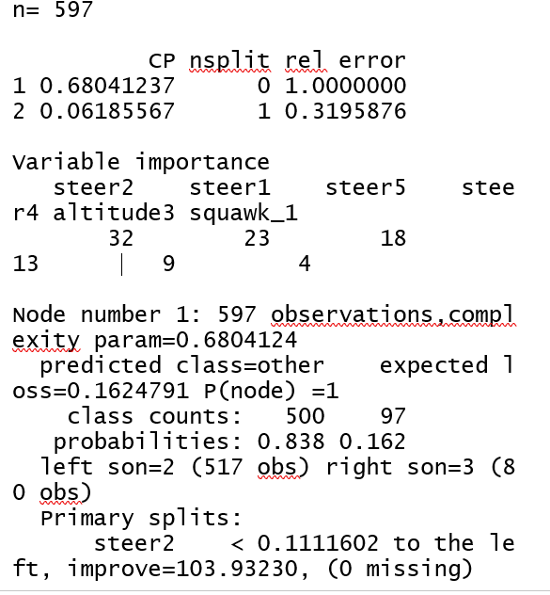
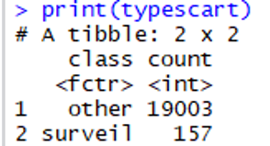
CART

Slide 30
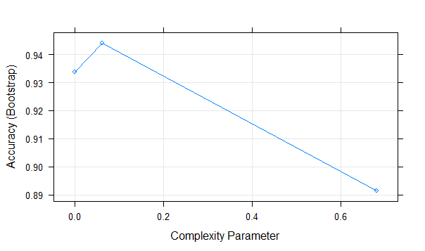
CART

Slide 31
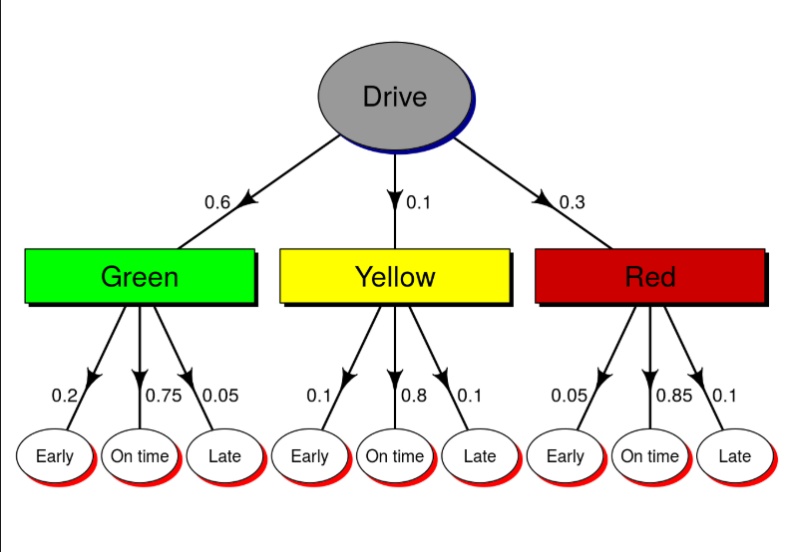
Conditional Inference Trees
Conditional Inference trees use recursive splitting pattern with early stopping. It uses binary splitting pattern like most other trees but for variable selection and split point search it applies conditional inference.
Resolves Overfitting.
An example based on the probability of arrival.

Slide 32
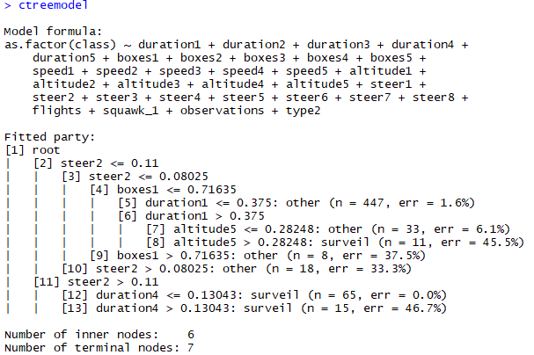
Conditional Inference Trees

Slide 33
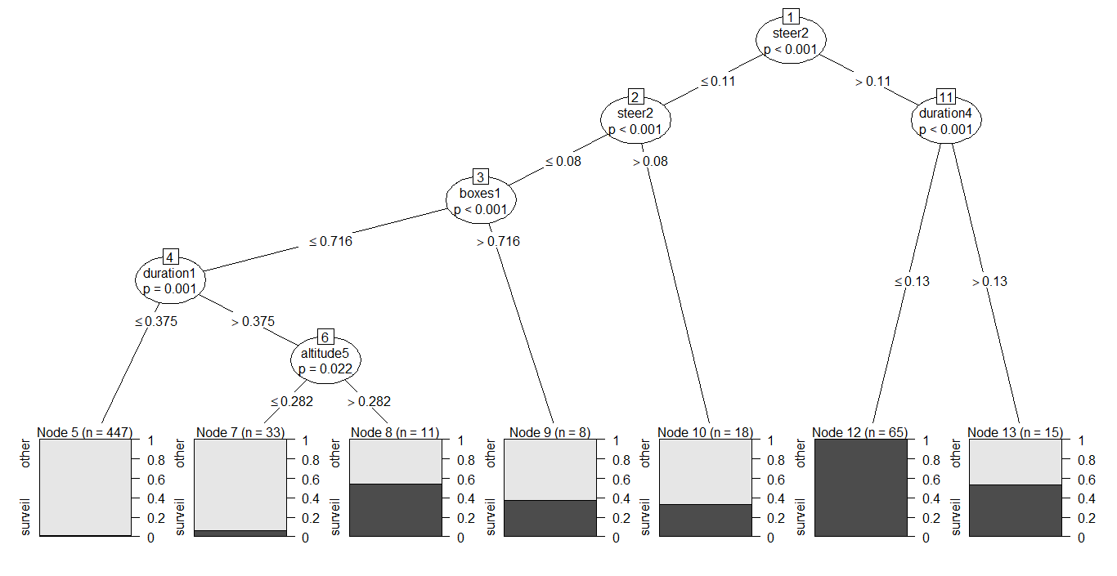
Conditional Inference Trees

Slide 34
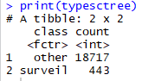
Conditional Inference Trees

Slide 35
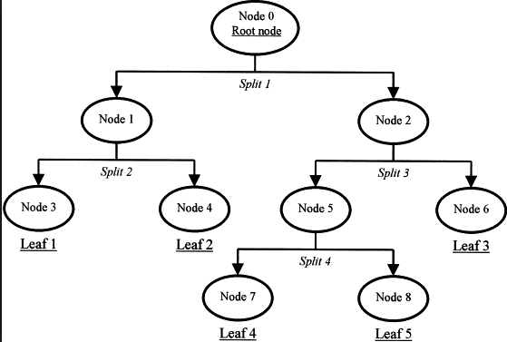
Evolutionary Learning Trees
The algorithm first initializes a set of trees with random split rules in the root nodes.
It terminates when quality of the best trees stops improving, but not later than a maximum number of iterations.

Slide 36
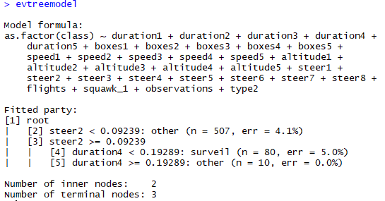
Evolutionary Learning Trees

Slide 37
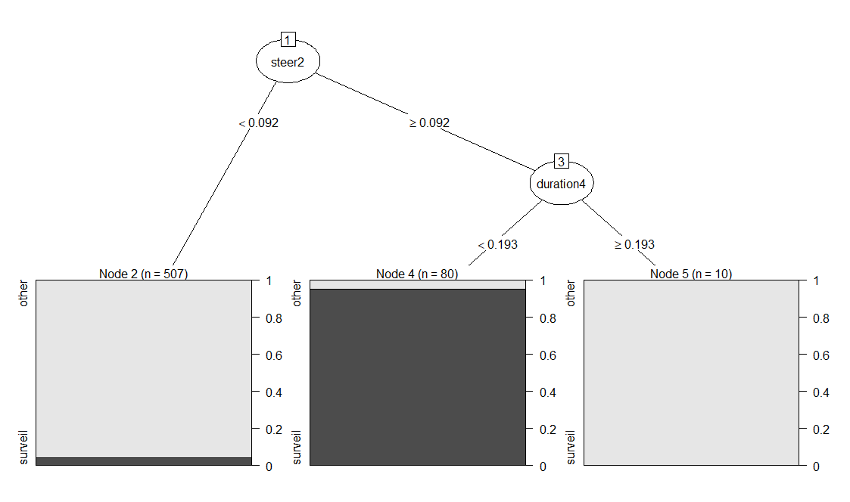
Evolutionary Learning Trees

Slide 38
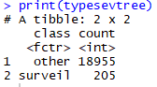
Evolutionary Learning Trees

Slide 39
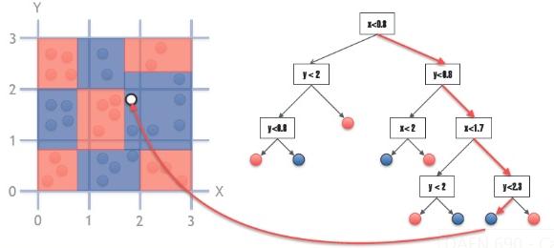
Bagged trees
It is a technique where the predictions from multiple machine learning algorithms are put together to make more accurate.
Model predicting a color based on it’s co-ordinates.

Slide 40
Bagged trees

Slide 41
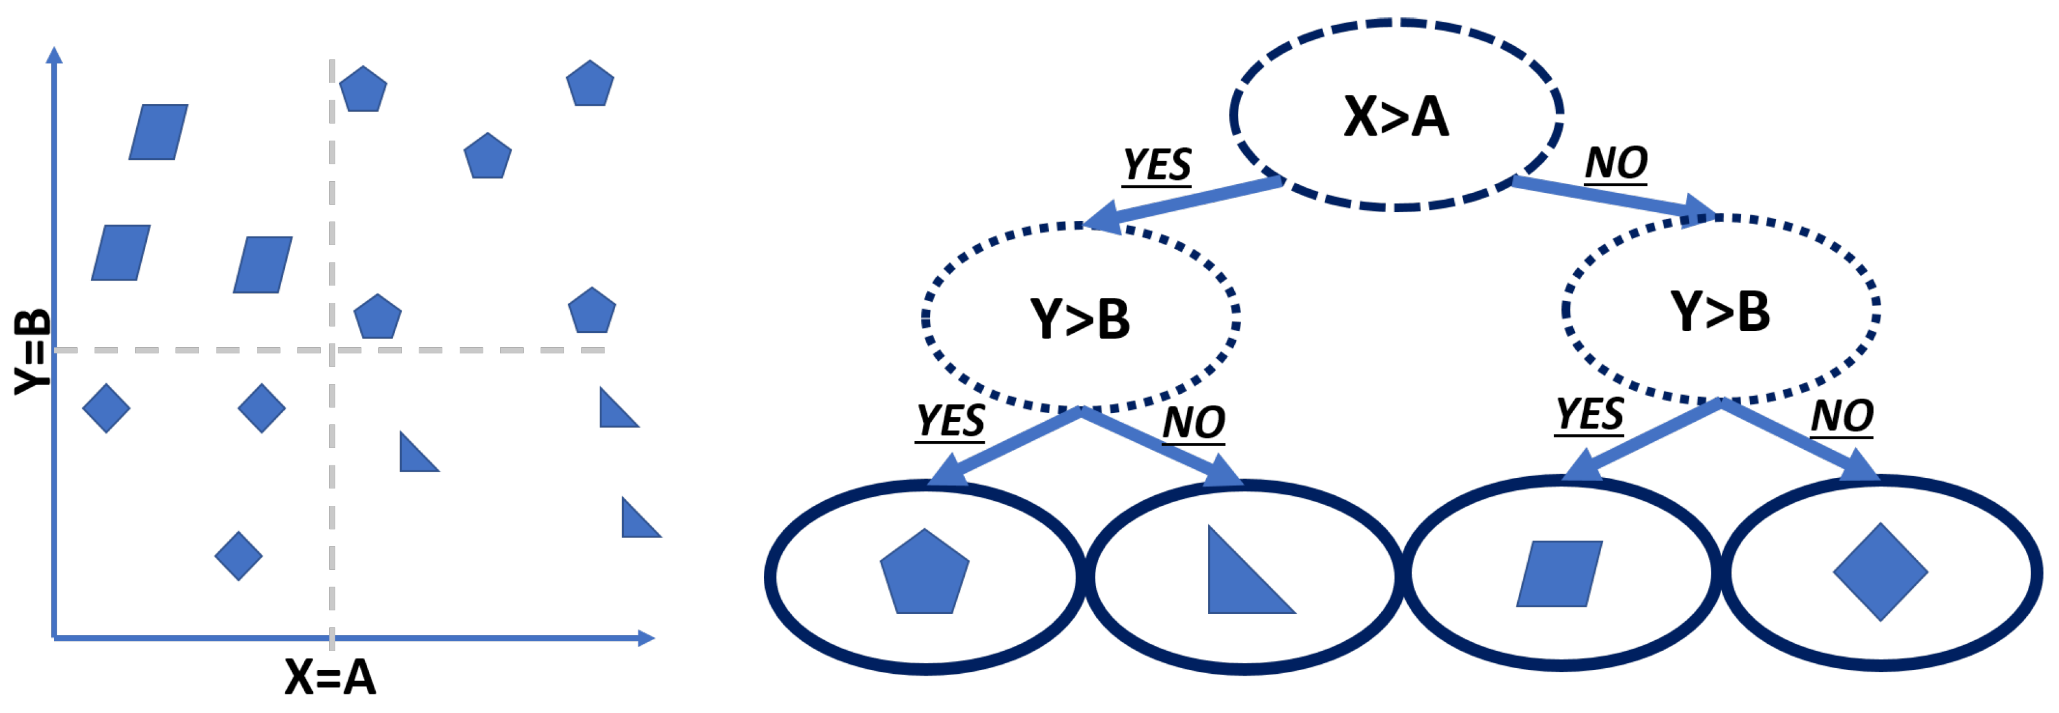
C4.5
It is a software extension of the basic ID3 algorithm, but an improvised version.
C4.5 is a computer program that is used for inducing classification rules in the form of decision trees for a given set of instances.
It builds a decision tree based on the attribute and the subset.

Slide 42
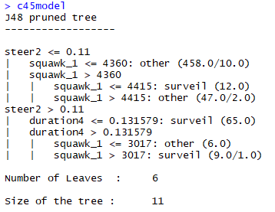
C4.5

Slide 43
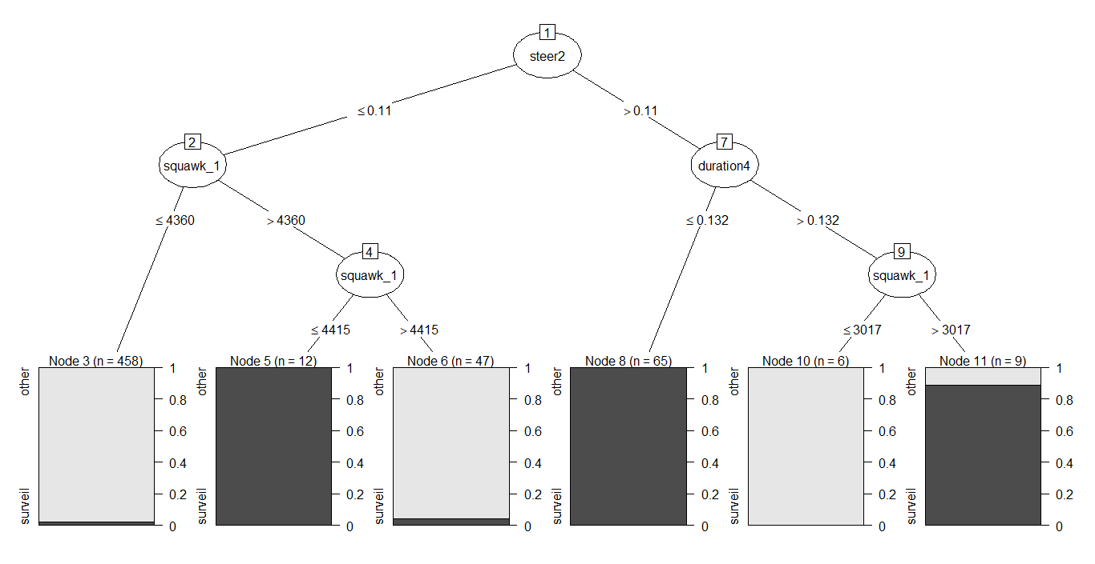
C4.5

Slide 44
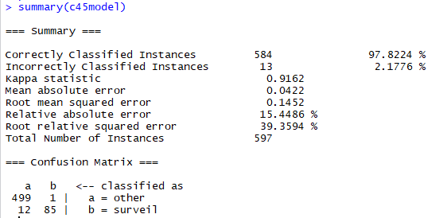
C4.5

Slide 45
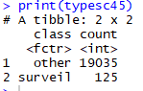
C4.5

Slide 46
Comparison of models
Models | Misclassification rate
Random Forest | 0.035
C4.5 | 0.022
CTree | 0.050
Cart | 0.052
EvTree | 0.042
Bagging | 0.047

Slide 47
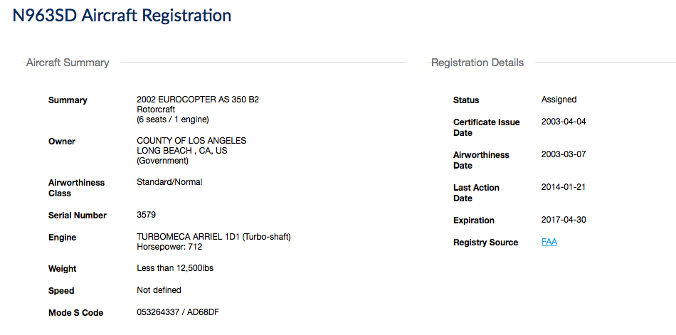
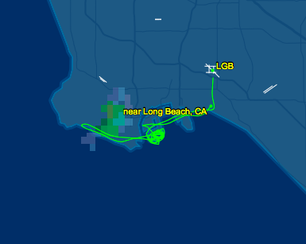
Validation
Scenario 1
Website : www.flightaware.com
The model was correctly able to classify the aircraft N963SD basing on its characters, flight path, speed and other parameters as a surveillance aircraft.

Slide 48
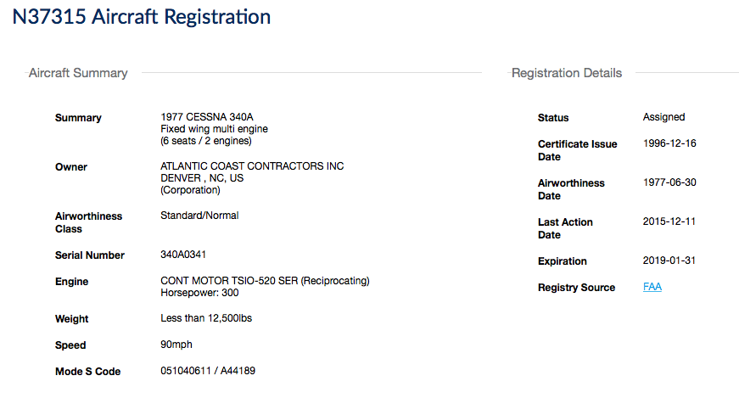
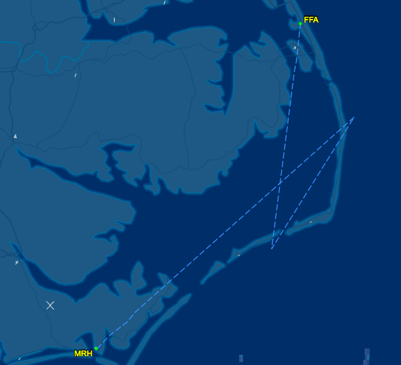
Scenario 2
The model was correctly able to classify the aircraft as an “other” flight which was validated by reconfirming the flight details. It clearly belongs to a private company.

Slide 49
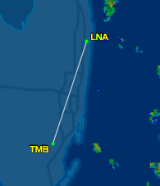
Scenario 3
The model wrongly classified this the above aircraft as a spy plane basing on the flight characteristics when it is showing as private owned plane on records.

Slide 50


